Slide 1
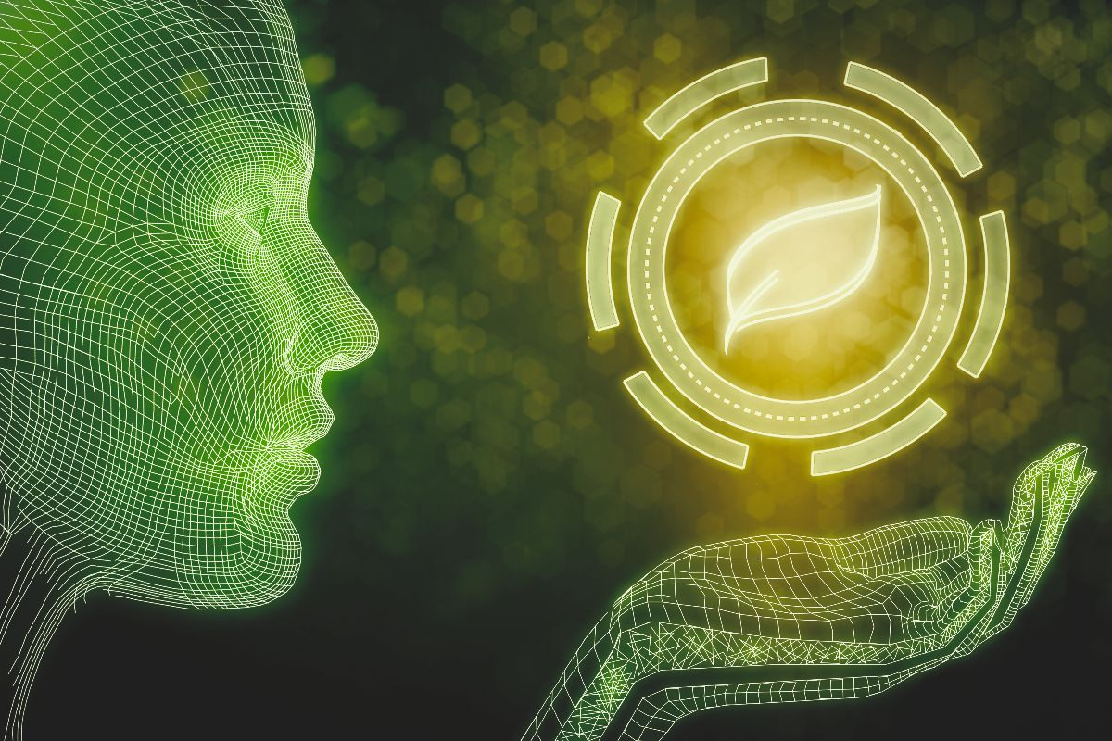


^{Circular 3d}
A digital platform that finds
the best sustainable material
for your product!

Slide 2
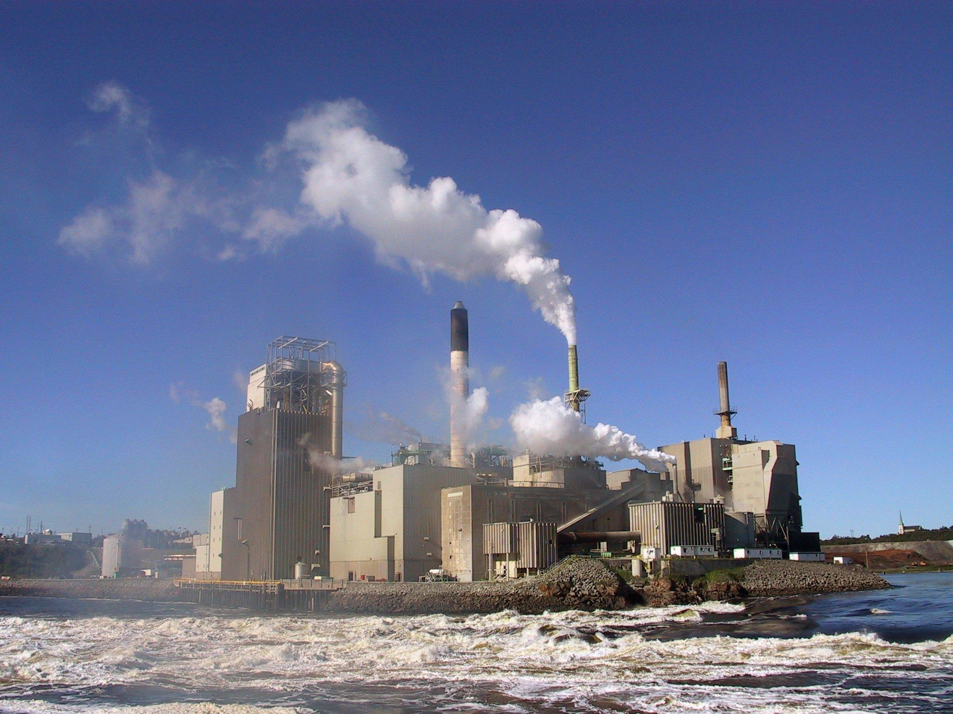
Problem
14 %
54 %
is the worldwide average recycling quote
of the world‘s energy are consumed by global manufacturing
> 80 %
> 90 %
of customers want to buy environmentally conscious products
of every conventional plastic material can be replaced with a bioplastic alternative
Notes:
Traditional manufacturing generates significant waste and relies on unsustainable materials.
However the majority of people want to buy sustainable products…
What if I would tell you that over 90 % of every conventional plastic material could be replaced with a sustainable alternative?

Slide 3
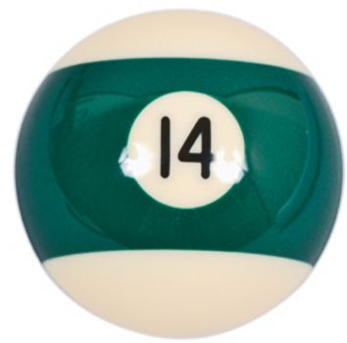
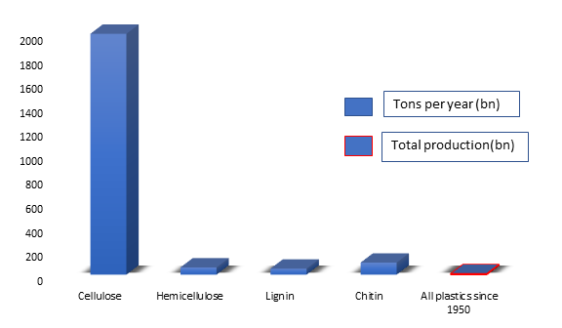
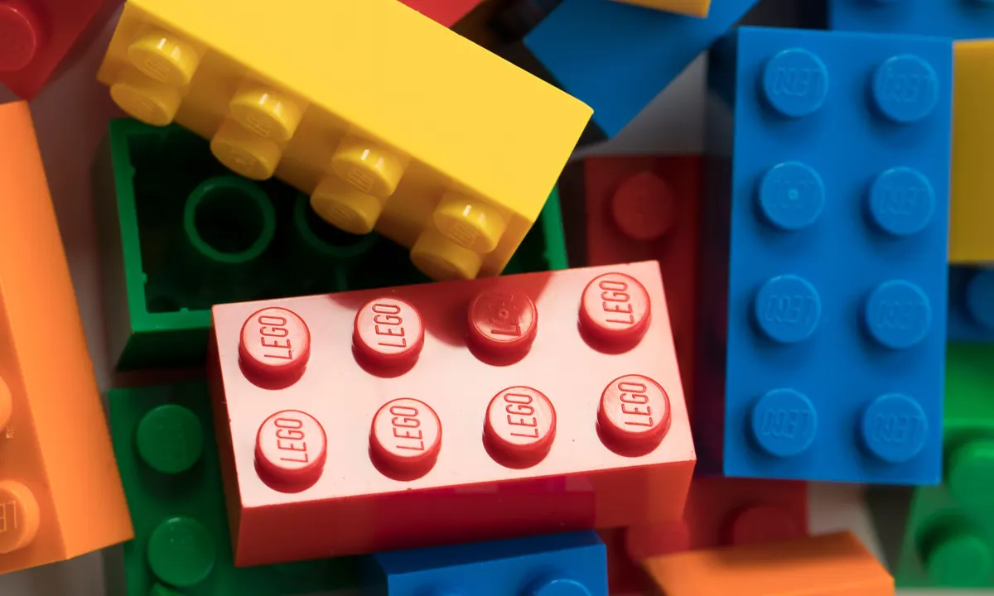
Organic Material vs. Plastic Production
1860
1949
Notes:
But is there enough biomass available to produce large amounts of bioplastics? The answer is yes!:
Every year, nature produces 2000 bio. tons of dead plants in form of cellulose and lignin
- this is more than all plastics ever produced since 1950!
In fact, the very first plastic product was a billiard ball made from cellulose in 1860. Even the first Lego stones in 1949 were made out of cellulose.
But also because of cheap oil at that time, we simply ignored cellulose and biomass as a sustainable source for bioplastic materials.
That is why most of our products are made of fossilbased resources which are harming our planet. However to fight climate change we need to change to renewable resources. But it is so hard to change an existing system. So let us rather use new technologies that disrupt the existing system. One of these technologies is 3D Printing: And with 3D Printing we have the possibility to design things in a better, more efficient way. That means the stability can come through the structure and we dont need to use so many materials anymore, which makes recycling so difficult. It is the technology which makes just more sense and with the growth of AI and other tech it will capture more and more of the manufacturing market. And that is why it is so important that we dont do the same mistake again but are making the technology sustainable from the beginning by using the right materials.
extra notes:
Ligno-cellulosic feedstock is an abundant waste product you can find in nature, such as cellulose in dead plants.
Is it actually possible and scalable to produce bioplastics? Well, yes: Every year 2000 bio. tons of Cellulose,an abundant waste product you can find in nature (like in dead plants) are produced worldwide. And in fact, the first plastic products, a billiard ball in 1860 and the first Lego stones in 1949, were made out of cellulose. But in the era of cheap oil we forgot about cellulose as a sustainable bioplastics resource.
(But that we have the capacity to cover all plastic needs becomes obvious with this graphic as the yearly produced rate of cellulose and other natural byproducts is much higher than all plastics ever produced.)

Slide 4
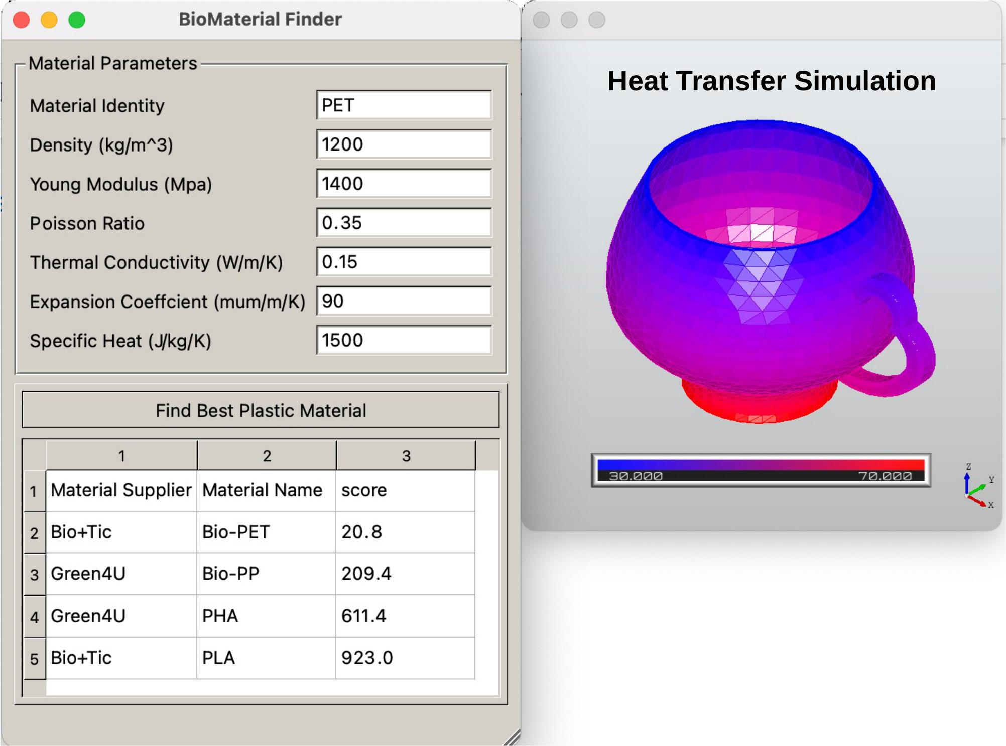
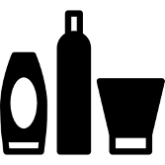

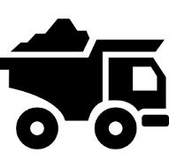
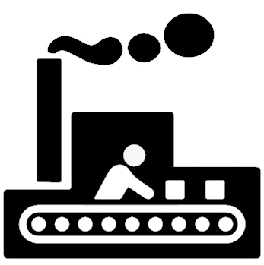

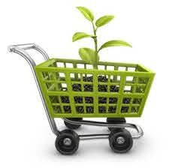
BioMaterial
Free version:
provide conventional plastics ID,
obtain closest bioplastics alternative offered by a supplier
Premium version:
optimize for the best bioplastic alternative in particular product
- 3D file upload (CAD)
Application-Specific,
Polymer Compounds, ...
Notes:
Therefore we have developed a Biomaterial Finder: A customer types in the requirements for the material (or the requirements could be determined with a simulation software) and the calculator shows the best available sustainable materials. For this we have developed a material data base with the help of IBM Deep Search and trained it with CoSine similarity. Our solution captures realtime data as well. And to show you how that works, we are going to show you a video.
finder, produktspezifisch
ToDos:
Application-Specific,
Polymer Compounds, ...

Slide 5
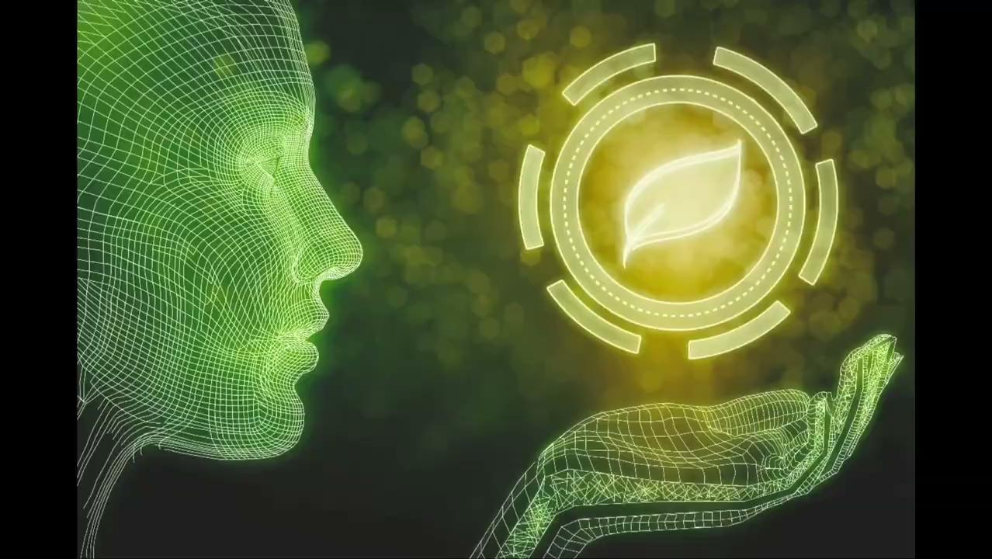
Notes:
We gathered real time data during the printing process for which we employed Bosch XDK sensors, empowered by Fetch.AI with which are measuring the temperature, humidity and pressure. We are using the inspection camera from Sick to better monitor the print during the process. In the end we are using all this data and are feeding it into to our solution to improve it further.

Slide 6
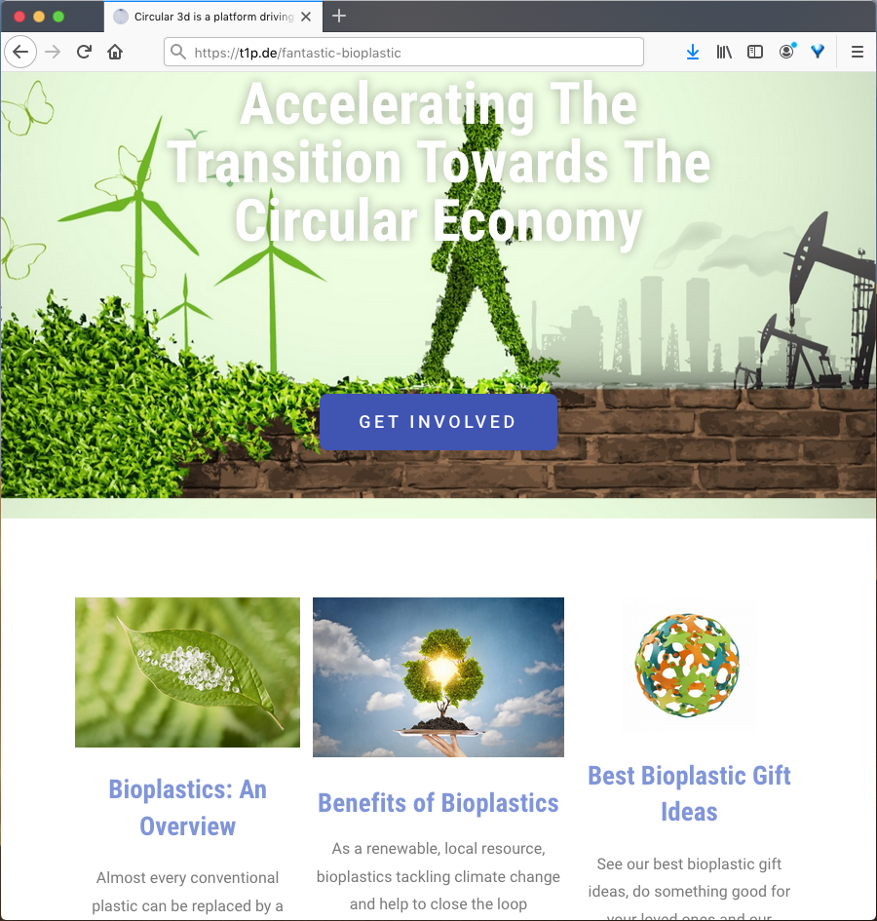
Education
03
End customers inform themselves
about Sustainable materials and Products
www.circular3dprinting.com
Notes:
To promote our solution further we have a website on which we educate customers about sustainable materials and their impact on the environment

Slide 7




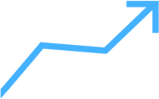
Client Benefits
Sustainable Impact
Speed and Quality
Cost Savings
Usability
Open Potential
Helps to save energy and CO2 emissions
Highlights the right products with the best prices
Neutral decision system
Helps to find the right material that improves part quality
Saves time because of quick matching process
Viable and enjoyable for users to use
Solution could be used for other manufacturing technologies
Notes:
Our client benefits are obvious: Our solution is sustainable, it sames money and time, leads to better quality because it identifies the best suitable material. It is easy to use and it could be employed for other manufacturing technologies or predictive maintenance

Slide 8
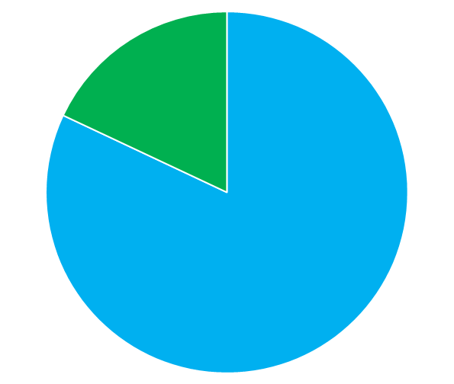
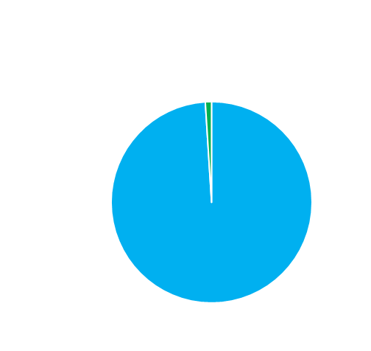

Addressable Market
Bioplastics 18 %
Bioplastics 1,5 %
CAGR:
20-30%*
2023
*Depending on various factors
2033
€ 658 B
Global Plastic Production
€ 1,050 B
Notes:
Right now the bioplastics market is pretty small. Within the next 10 years, however, our platform will benefit from a growing bioplastics market share with a growth rate of 20-30% per year. About the same growth rate can be expected for 3D Printing.
---
Within the next ten years, however, bioplastics will grow up to an estimated 18% market share.
------
*Depending on development of advanced biopolymers, reduced costs, political regulations and increased consumer awareness

Slide 9
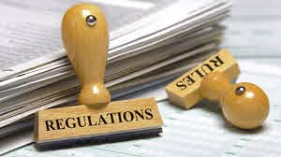
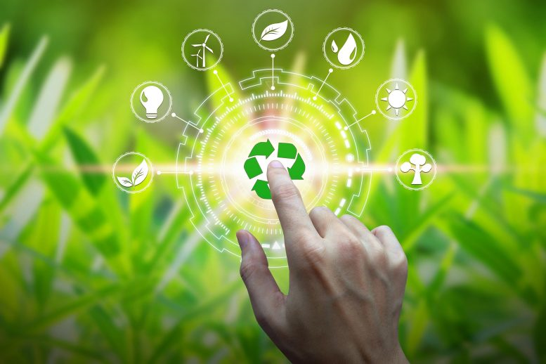
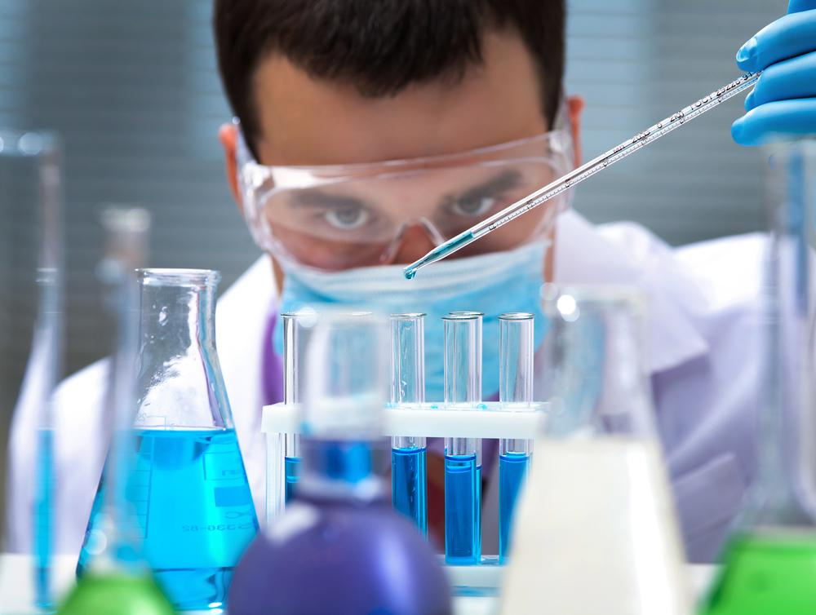
Market Drivers
Increasing customer demand
Health
Online Trend
Plastic Tax
Subsidies
Scale Effects
Policy Engagement
Scientific Breakthroughs
Corporate Vision
Big Brands adopt bioplastics
Oil depletion
New technologies
Green New Deal
Notes:
These growth rates are driven by an eco-friendly shift in policy engagement, corporate responsibility and scientific breakthroughs.
… and scientific breakthroughs.
---
The three most important market drivers for Bioplastics are Policy Engagement, Corporate Vision, and Scientific Breakthroughs.
(And with the green new deal and other political measurements they are focussing heavily on the transition from a fossil-based to a bio-based economy)
(and has its own sustainable materials center and there is the Bioplastic Feed Alliance consisting of companies like Coca-Cola , Danone, Ford, Nestle to drive the developments of bioplastics)
Recently a bioplastic was developed that can break down in the natural environment shortly after entering the sea. (And in the research center Desy in Hamburg they have developed a material from cellulose that is stronger than steel and should be available as a commercial solution in three to five years.)
(The EU’s willingness to transition from a fossil-based to a bio-based economy seems unshakable. )

Slide 10
Business Model
Online Platform
Free Software
Paid Software
Advertising
Commission
Fixed Fee
0.20 €
5 %
60 €
Cost Per Click
On Product Sales
Monthly / user
Notes:
Our business model takes advantage of all these market drivers and we will charge through advertisement, commission, and a fixed simulation software fee.
In our business model, we serve suppliers, manufacturers, and consumers of bioplastics.
However, will charge only suppliers and manufacturers for our platform through advertisement, commission, and a fixed simulation software fee.

Slide 11
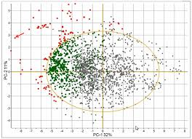

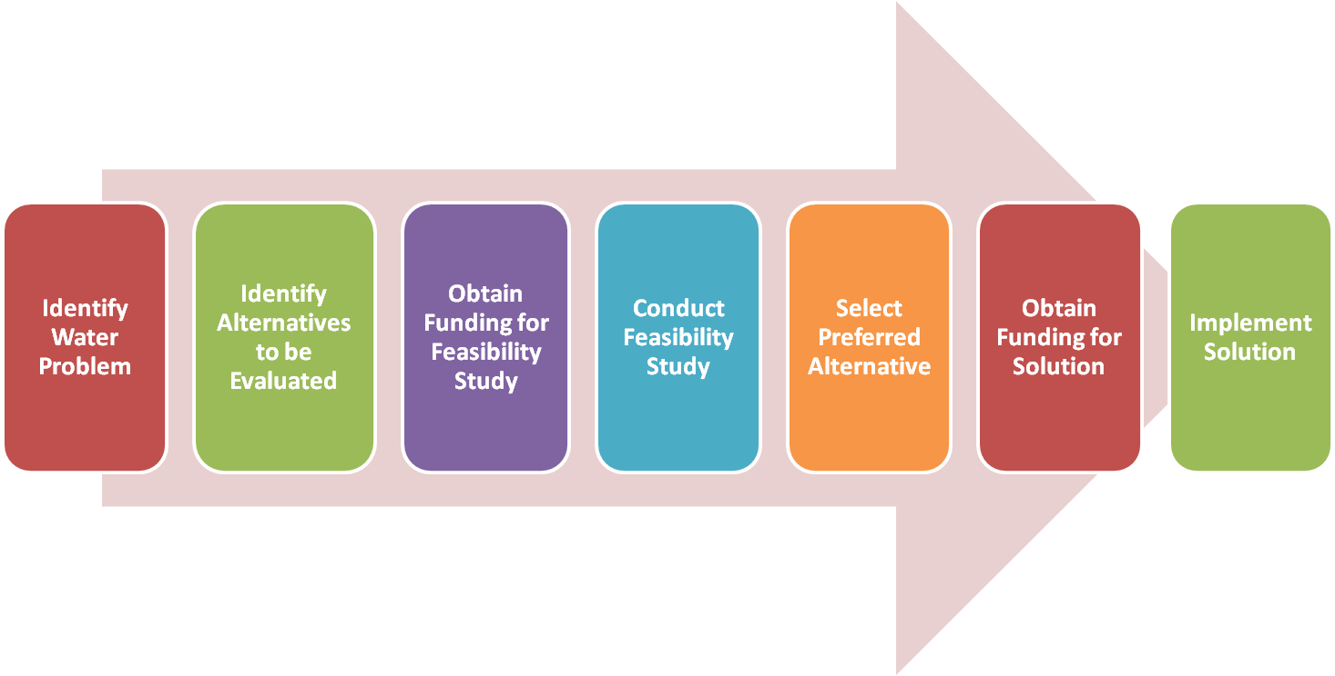
Next Steps (MVP)
Data integration of more materials
Matching Process with desired properties
Closed Pilot Program

Slide 12
Client benefits
Speed and Quality
Cost savings
Open potential
Helps to find the right material that improves part quality
Saves time because of quick matching process
Very userfriendly due to it’s simplicity
Customer saves money because solution highlights the right products with the best prices
Neutral decision system
Solution could be also used for other applications like predictive maintenance

Slide 13
Client Benefits
Sustainable Impact
Cost Savings
Speed and Quality
Usability
Open Potential
Notes:
“Lots of people think that UX simply means “is it user friendly. But it’s beyond that, its should make an app viable and enjoyable for users to use.
Other Benefits like meal/coffee options

Slide 14


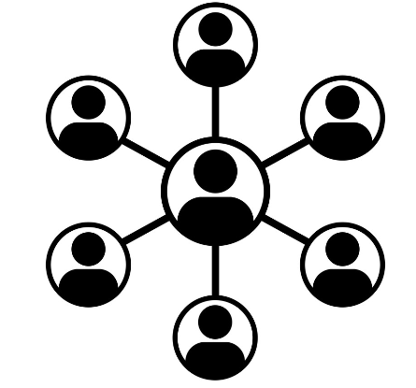
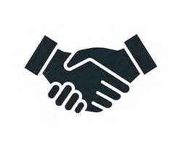
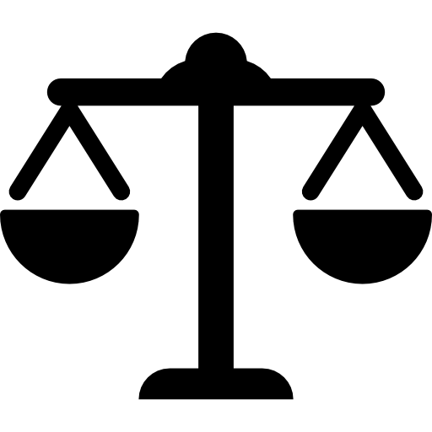
Competitive Advantages
1st to Market
Ease of Use
Specialized Portfolio
Network Effects
Trust through Reviews
Neutral Decision System
Notes:
… and a neutral decision-making system.

